Slide 1

Rain Water Detection System TEITA-1
St. Francis Institute of Technology
Department of Information Technology
Mini Project – Sensor Lab (ITL 603)
Vedant Kadam 1
Ethan Moreas 2
Josh Jestine 3
Akshat Oza 4
Pratham Gaonkar 16
Mentor:
Dr. Prachi Raut
HOD

Slide 2
Overview
Introduction
Literature Survey
Research Gaps
Problem Statement
Objectives
System Design
Hardware and Software Requirements
Circuit Diagram
Results & Discussion
Conclusion
References

Slide 3
Introduction
Turfs often become inaccessible because of sudden rain.
A mechanism is in place to close the Turf’s roof to prevent it from becoming wet.
The said mechanism though has to be turned on manually with the press of a button and often isn’t in time to prevent the Turf from becoming wet.
A Rain Water Detection Sensor could detect rain and immediately turn on the roof.

Slide 4
Literature Survey
Interfacing Soil Moisture Sensor with Arduino Uno
M. S. Kumar, T. R. Chandra, D. P. Kumar and M. S. Manikandan, "Monitoring moisture of soil using low cost homemade Soil moisture sensor and Arduino UNO," 2016 3rd International Conference on Advanced Computing and Communication Systems (ICACCS), Coimbatore, India, 2016, pp. 1-4, doi: 10.1109/ICACCS.2016.7586312.

Slide 5
Research Gaps
One major research gap is the development of low-cost and efficient rainwater detection sensors that can accurately detect and measure rainfall.
Another research gap is the integration of rainwater detection systems with smart water management systems. This can enable the automatic collection of rainwater data and facilitate the optimization of water usage in households, industries, and agriculture.

Slide 6
Problem Statement
The problem statement for this project is to create an automatic rain detection system using an Arduino Uno.
The system should also be low-cost and reliable.
The system should be designed in such a way that it is reliable and can be used in a variety of environments. The system should also be able to accurately measure and analyze rainfall levels.

Slide 7
Objectives
To keep the Turf from getting wet, a mechanism may be used to close the roof.
In normal household, with the help of rain water detector we can automatically save the rain water.
This can also be used if there is a chemical rain also. This is very common in industrial areas.

Slide 8
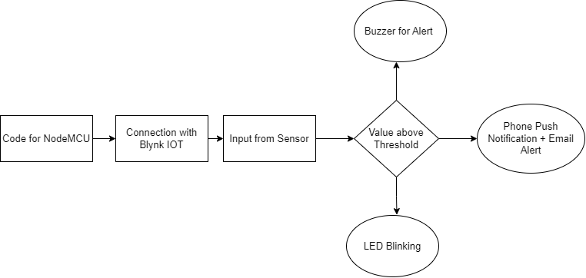
System Design

Slide 9
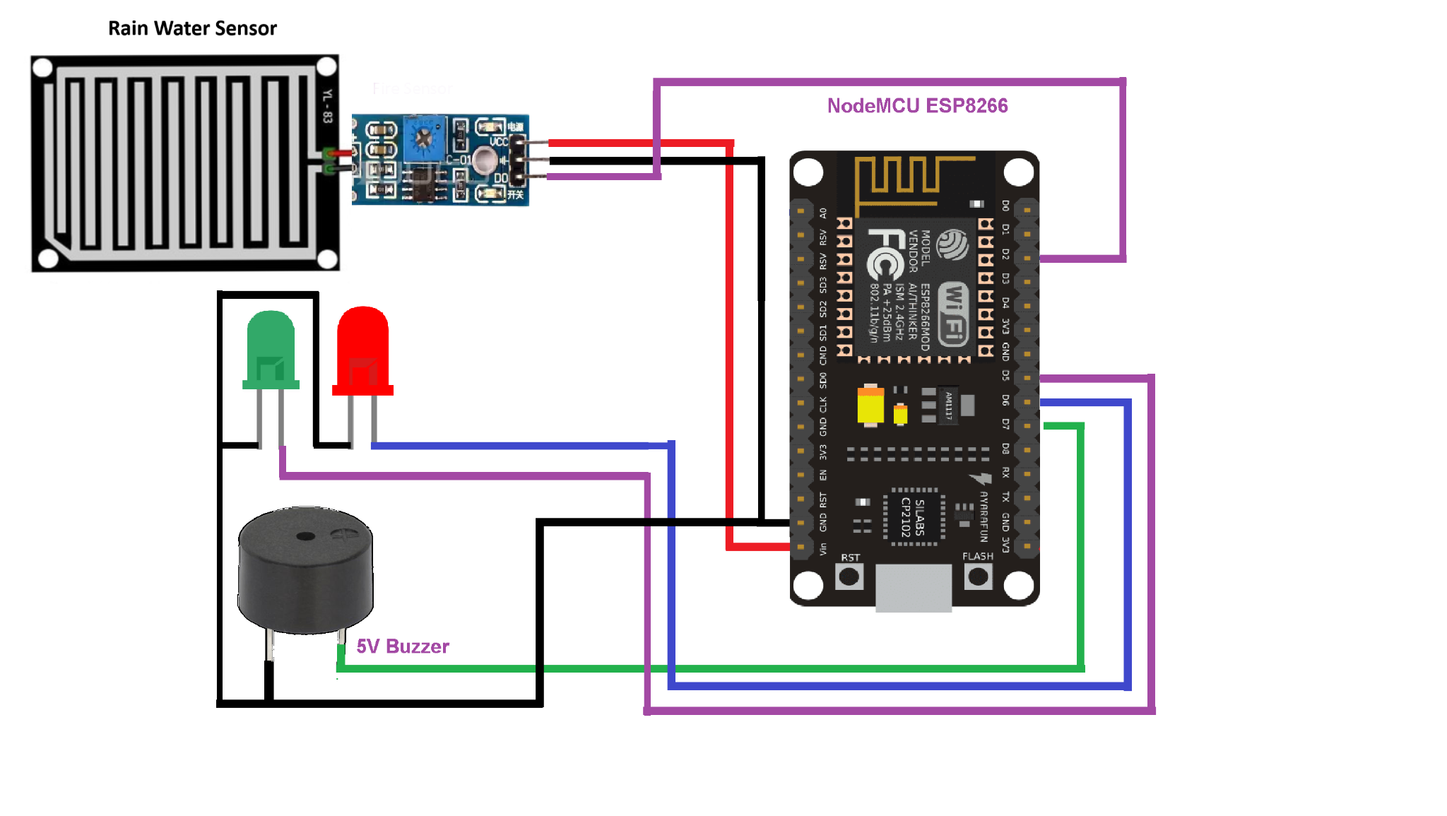
Circuit Diagram

Slide 10
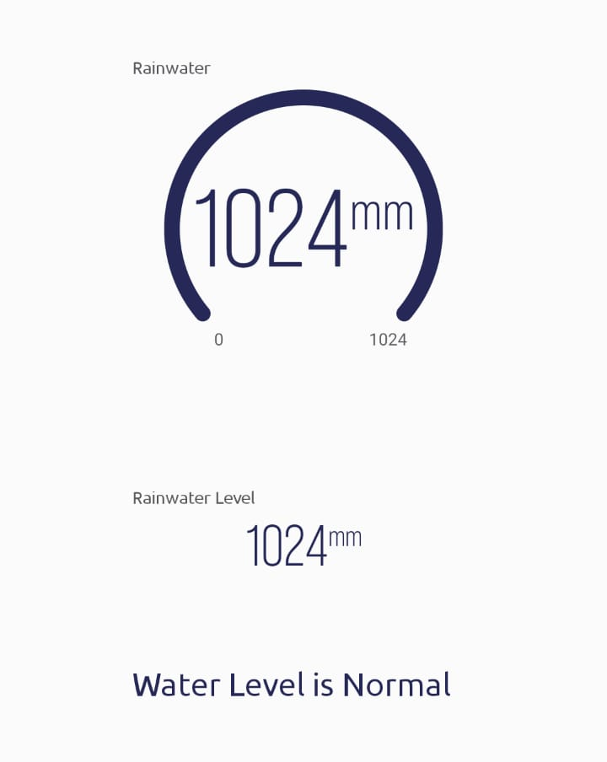

Results
Mobile and email Push Notifications

Slide 11
Hardware and Software Requirements
Hardware
Nodemcu Esp 8266
Buzzer
Led
Rainwater sensor
Jumper wires
Breadboard
USB cable type A/B
Software
Blynk IOT platform

Slide 12
Conclusion
In conclusion, an automatic rain detection system using a nodemcu can be created to accurately detect and measure rainfall.
The system should be designed to be reliable and able to withstand a variety of environmental conditions. The system should also be designed to be low-cost and easy to maintain.
Overall, a rainwater detection system using ESP8266 is a great way to automate the process of monitoring rainfall and provide accurate data for a variety of purposes.

Slide 13
References
[1] "Development and evaluation of a low-cost rainfall detection system for urban hydrology" by S. Kim, S. S. Yeo, and J. Kim, 2019.
[2] "Rainfall estimation using microwave links from cellular communication networks" by M. Tsukamoto, T. Kawanishi, and H. Hanado, 2018.
[3] "Design and development of a smart rainwater harvesting system for domestic households" by S. S. Vaishnav and S. S. Deshmukh, Sustainable Cities and Society, 2018.

